Slide 1

Theological Libraries for Alternative Spiritualities
Theological Libraries for Alternative Spiritualities
Joanne Fitzpatrick
Lancaster University
Joanne Fitzpatrick
Lancaster University
Photo by Nurlan Imash on Unsplash

Slide 2
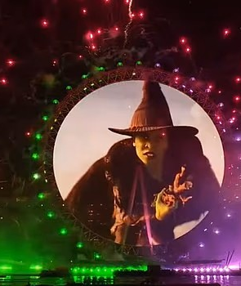
the only full-formed religion which England can be said to have given the world
Wicca
Thelema
Chaos Magick

Slide 3
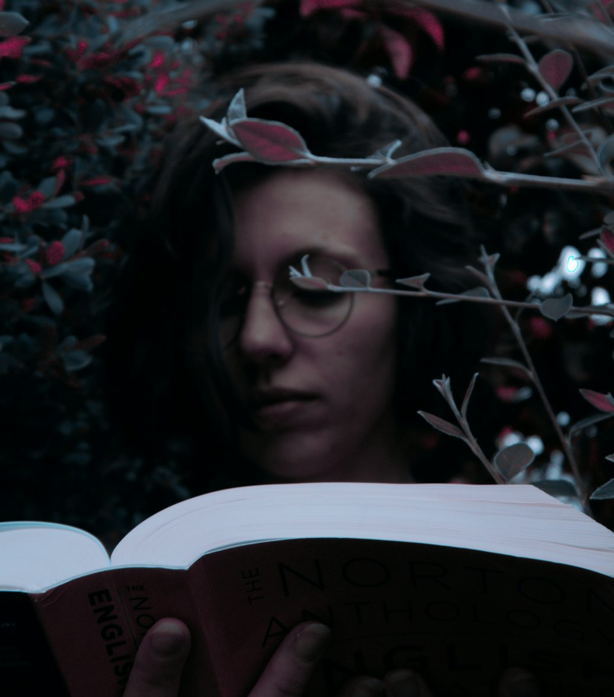
What libraries do we have?
Not for profits
  The Museum of Witchcraft and Magic
  The Library of Avalon
Special Collections
  Ferguson Collection at University of Glasgow
  Harry Price library at University of London
Member Institutions
  Theosophical Society in England and Wales
  Museum of Freemasonry
Internet Archives
  Internet Sacred Text Archive
  Hermetic Library
Photo by Jeżs Lażkano on Unsplash

Slide 4

User Types
Practitioners and leaders of alternative religions
Academics
Organisational members
Non-practitioners

Slide 5

I know about that!
Fitzpatrick, Joanne, 2022. “If That Which Thou Seekest Thou Findest Not Within Thee, Thou Wilt Never Find It On The Internet: How Practitioner Contemporary Pagans and Ritual Magicians Access and Use Information.” Pomegranate 23 (1-2): 203–231. https://doi.org/10.1558/pome.22512.

Slide 6







Issues and Complexities
Excessive criticism
Access for all
Personal archives
Oath bound information
British heritage
Guerrilla open access
Gnosis over learning

Slide 7
Issues and Complexities
Excessive criticism
Access for all
Personal archives
Oath bound information
British heritage
Guerrilla open access
Gnosis over learning

Slide 8





Themes
Power structures
Social status and class consciousness
Legitimacy
Anti capitalism
Non-rational information formats

Slide 9





Solutions
Library to librarian links
Research funding
Open access via social enterprise
Academic to practitioner links
Transparency

Slide 10
Thankyou!
Any Questions?
Photo by Nurlan Imash on Unsplash

Slide 11
Discussion Topics
How can the preservation of minority spiritualities be justified within current funding frameworks?
How can librarians work respectfully within traditions that distrust institutions?
Do closed libraries and initiatory access inevitably reproduce class-based exclusion?
If knowledge is validated through personal gnosis or consensus, how can misinformation be identified?
Can social enterprises recreate diamond open access publishing within the private sector?
Can increased openness cause harm to individuals who are unprepared for certain knowledge?
What practical actions could ABTAPL realistically take in this space? How can we work together some more?

Slide 12
Connecting with me
j.fitzpatrick2@lancaster.ac.uk
@jofitz.bsky.social
www.linkedin.com/in/joanne-fitzpatrick-462646253
https://www.lancaster.ac.uk/library/open-research/
Photo by Jeżs Lażkano on Unsplash

